Slide 1


YEAR 7 2026
PARENT INFORMATION SESSION 1

Slide 2

ACKNOWLEDGEMENT OF COUNTRY

Slide 3
WELCOME & OVERVIEW
  PRINCIPALS ADDRESS
  INTRODUCTION TO CESSNOCK HIGH SCHOOL
  ENROLMENT PROCESS
  TRANSITION CALENDAR
  MIDDLE SCHOOL STRUCTURE
  QUESTIONS
  SCHOOL TOUR

Slide 4

PRINCIPAL ADDRESS
  WELCOME TO THE PARENTS AND CARERS OF YEAR 7 2026
  PARENT / STUDENT EXPECTATIONS
BELINDA COOPER
Rel. PRINCIPAL

Slide 5
INTRODUCTION TO CESSNOCK HIGH SCHOOL
BELINDA COOPER
Rel. PRINCIPAL
  ESTABLISHED IN 1937
  CURRENT ENROLMENT - 627 STUDENTS
  TEACHING STAFF 70 - SASS STAFF 50
  10 SPECIAL EDUCATION CLASSES THAT FORM THE SEEK LEARNING CENTRE
  25.3% ABORIGINAL AND TORRES STRAIT ISLANDER STUDENTS
  ABORIGINAL LEARNING AND ENGAGEMENT CENTRE (KIRAWA LEARNING CENTRE)
  COMMERCIAL KITCHEN FOR TRADE TRAINING
  SENIOR LEARNING CENTRE
  EXTENSIVE FACILITY UPGRADGES
  TECHNOLOGY FOR ALL
  OPPORTUITIES FOR ALL!

Slide 6
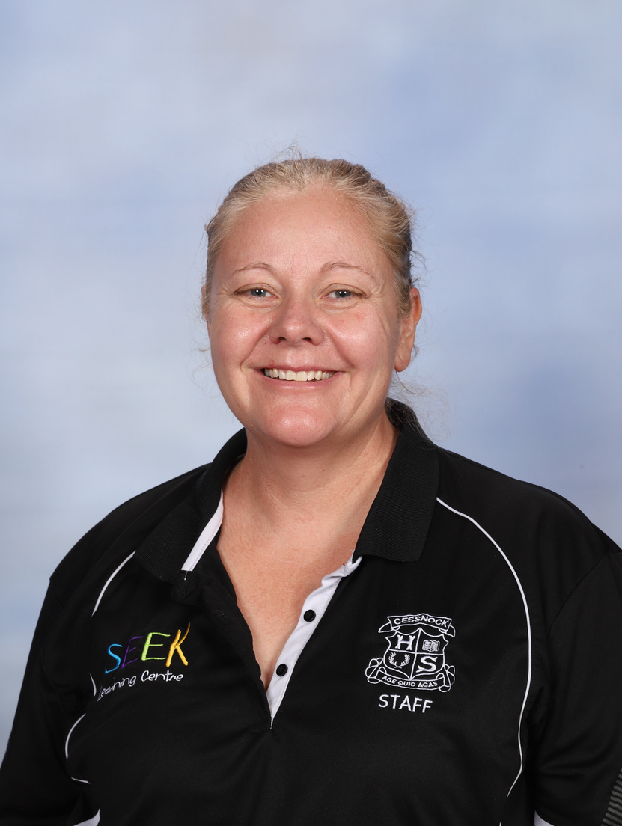

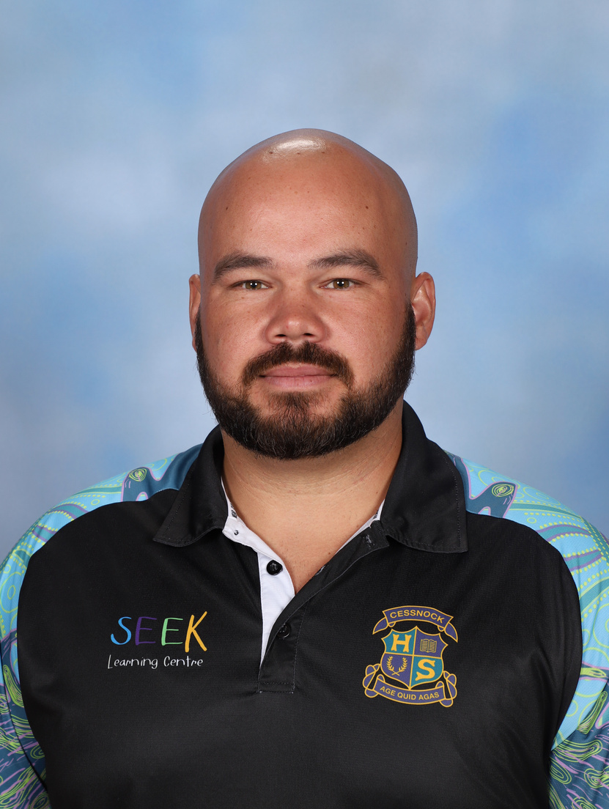
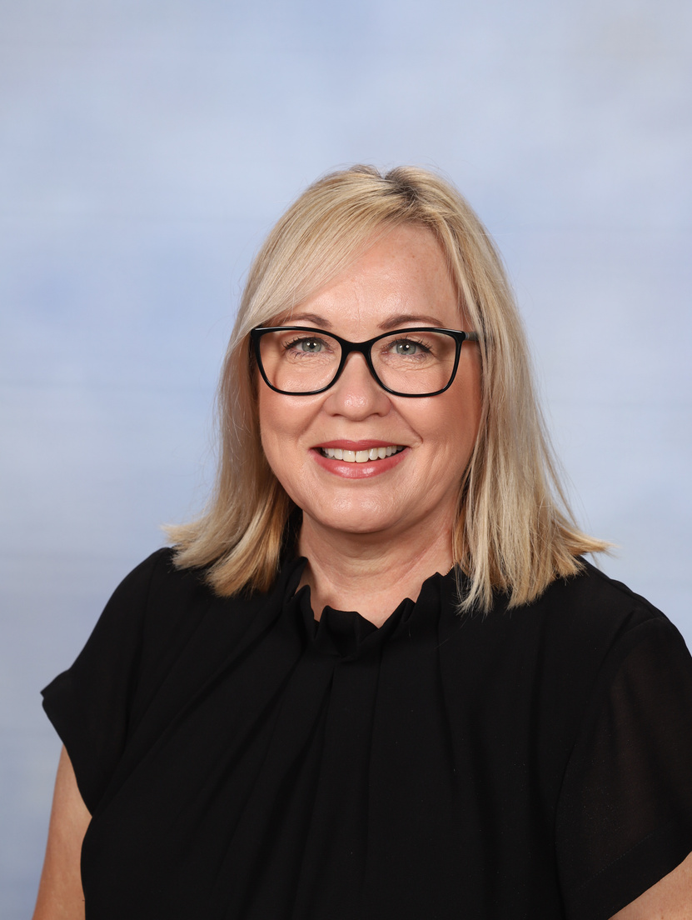
KEY STAFF INTRODUCTION
DEPUTY PRINCIPALS
7, 9, 11 (2026)
REL. 8, 10, 12 (2026)
REL. INCLUSION & SUPPORT
LEAH WATTS
TY SWADLING
ROBERT PLAIN

Slide 7
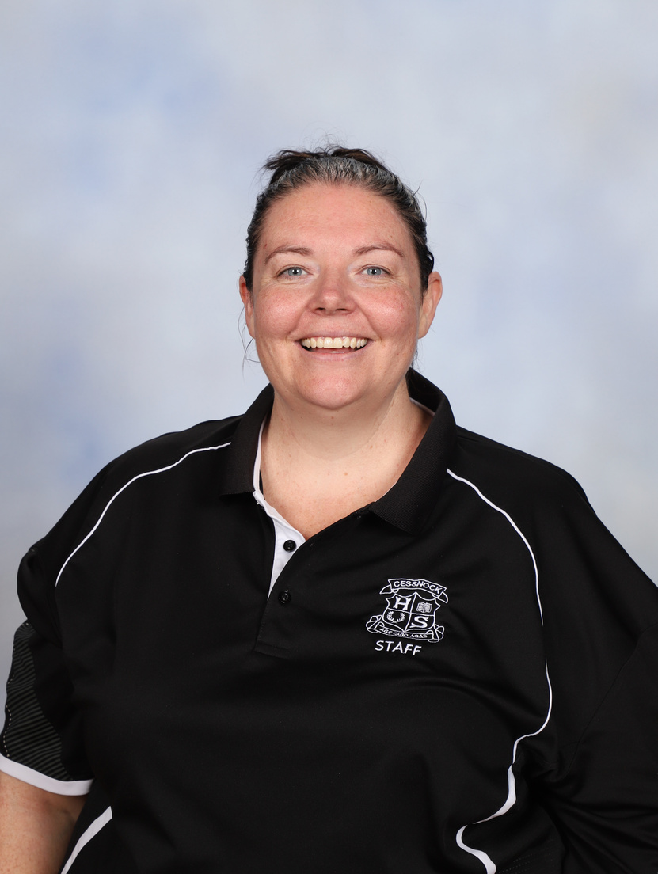

KEY STAFF INTRODUCTION
WELLBEING TEAM
YEAR 7 ADVISER
2026
2IC YEAR 7 ADVISER
2026
STUDENT SUPPORT OFFICER
HT WELLBEING
TBC
TBC
STACY JACOBS
ROBERT EATON

Slide 8
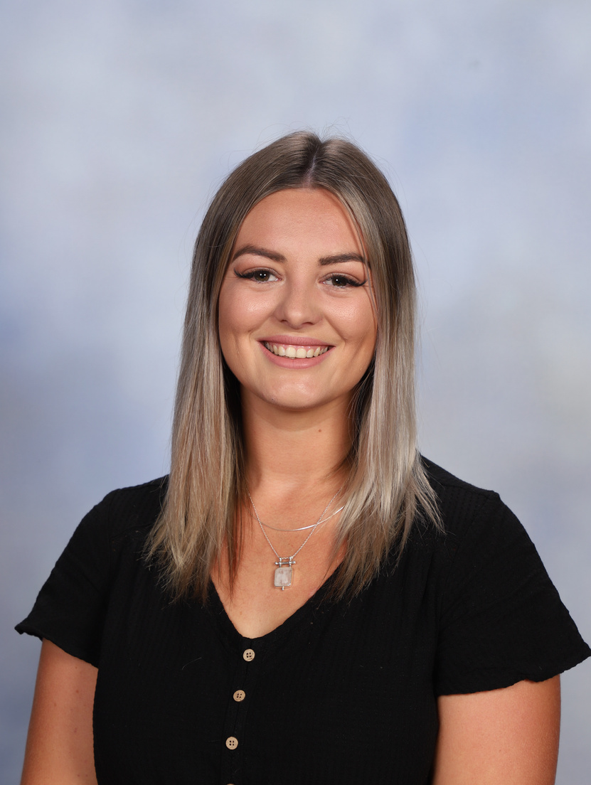
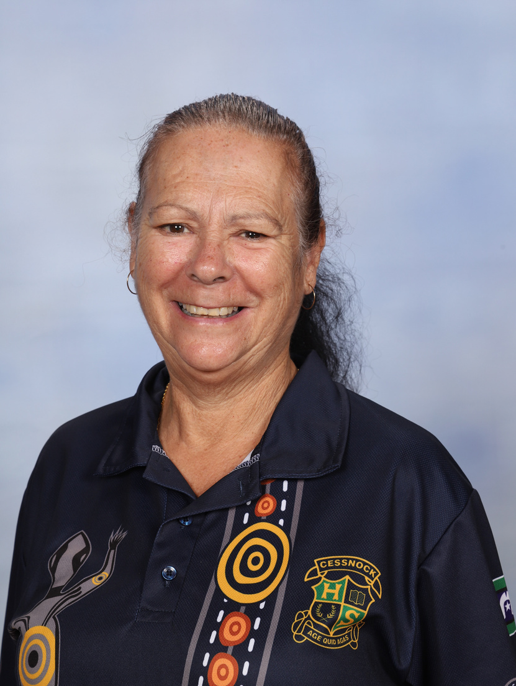


KEY STAFF INTRODUCTION
ABORIGINAL EDUCATION TEAM
HT TEACHING AND MENTOR
ABORIGINAL EDUCATION OFFICER
ABORIGINAL IDENTIFIED SLSO
ABORIGINAL ENGAGEMENT SUPPORT
KRISTEN POLLOCK
KERRIE ROBERTS
BOSTON MOORE
TYLER YOUNIE

Slide 9
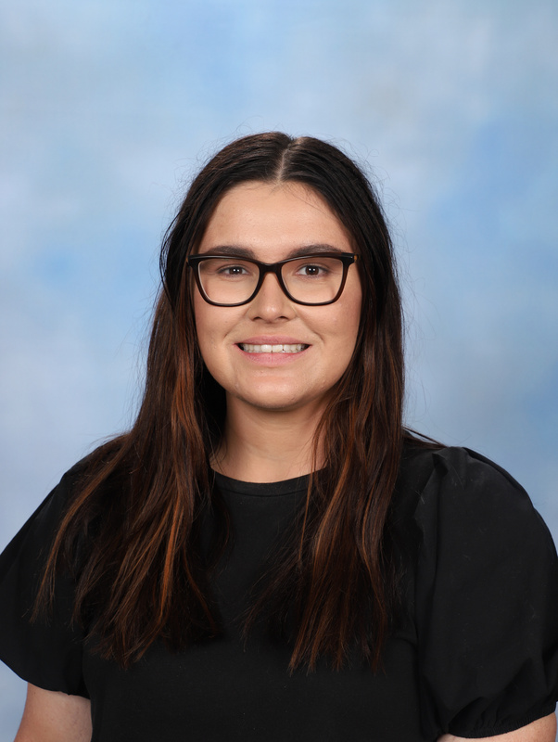
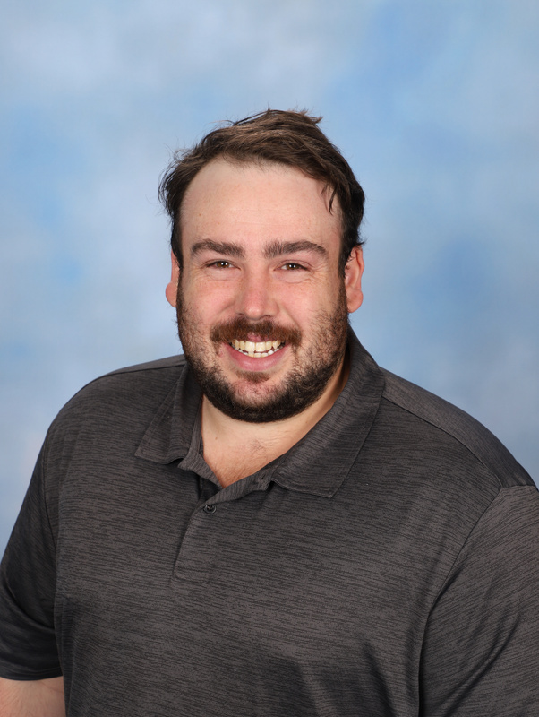
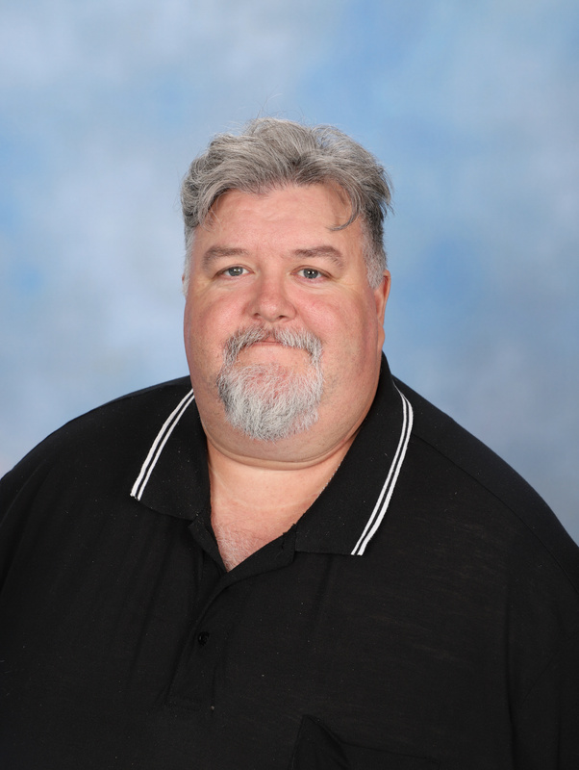
KEY STAFF INTRODUCTION
ABORIGINAL EDUCATION TEAM
KLC TUTOR
(STAGE 4)
KLC TUTOR
(STAGE 5)
KLC TUTOR
(STAGE 6)
ROSE LUCAS
PAT GIBSON
CHRIS PENGLAZE

Slide 10


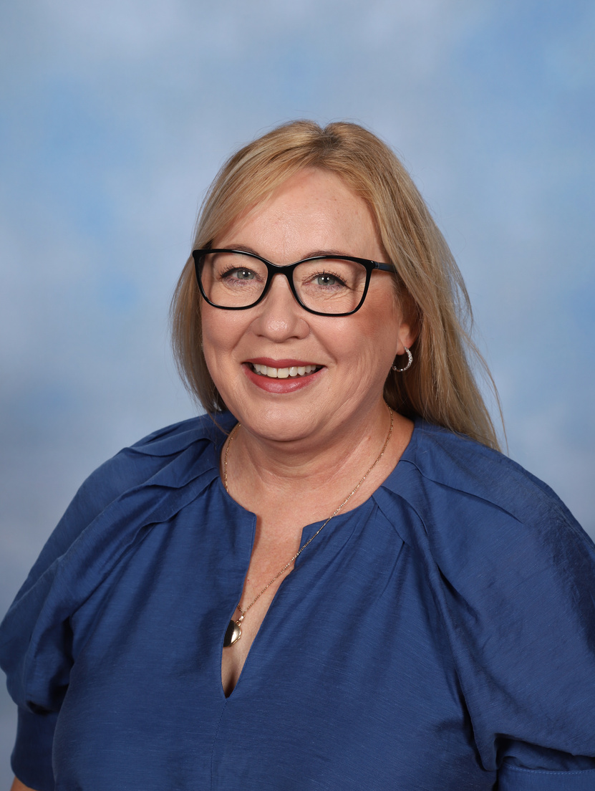

KEY STAFF INTRODUCTION
THERAPY DOGS
PADDY
INDI
FERGUS

Slide 11
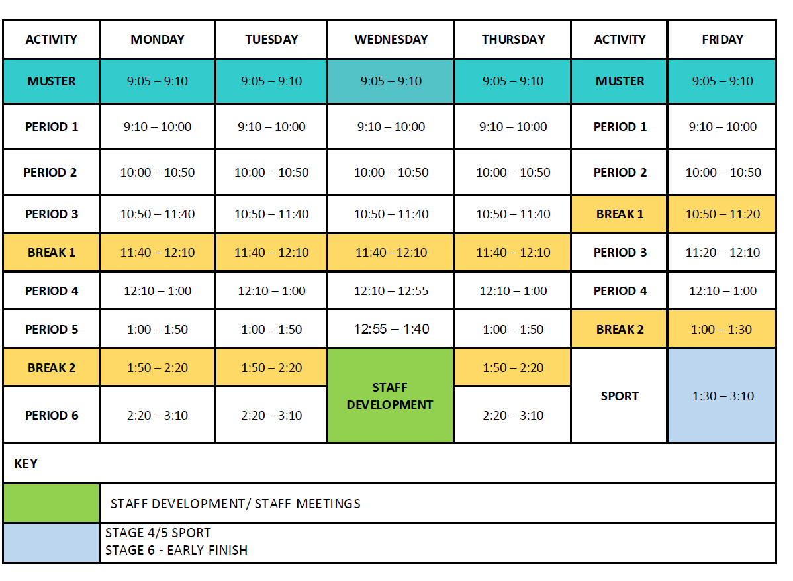
BELL TIMES

Slide 12

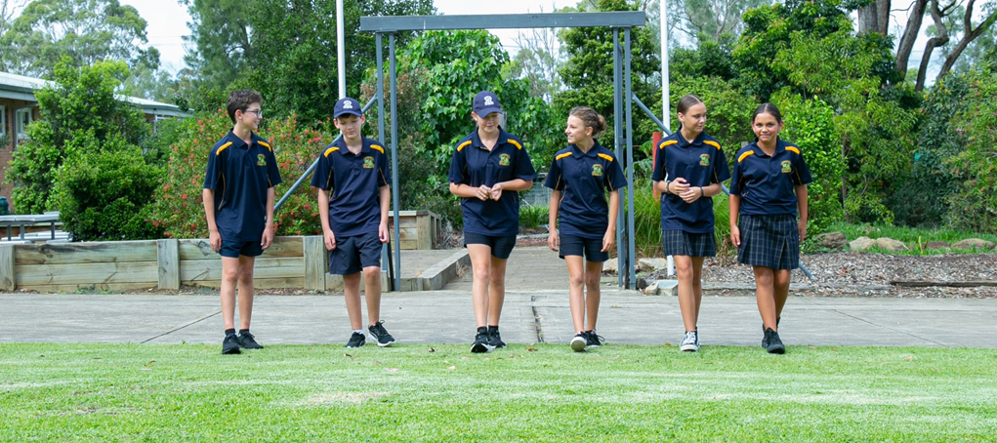
UNIFORM

Slide 13
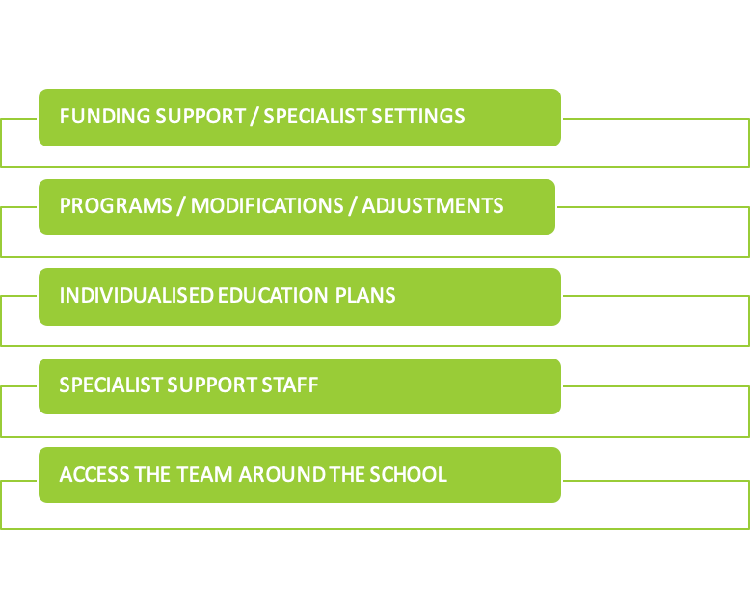
LEARNING & SUPPORT
  LEARNING AND SUPPORT TEAMS CORE BUSINESS SUPPORTING STUDENTS TO ACIEVE ON THE SAME BASIS AS THEIR PEERS BY IMPLEMENTING REASONABLE ADJUSTMENTS AND TEACHING STRATEGIES TAILORED TO MEET THEIR INDIVIDUAL NEEDS
ANY ENQUIRIES PLEASE CALL THE OFFICE AND ASK FOR ROBERT PLAIN

Slide 14
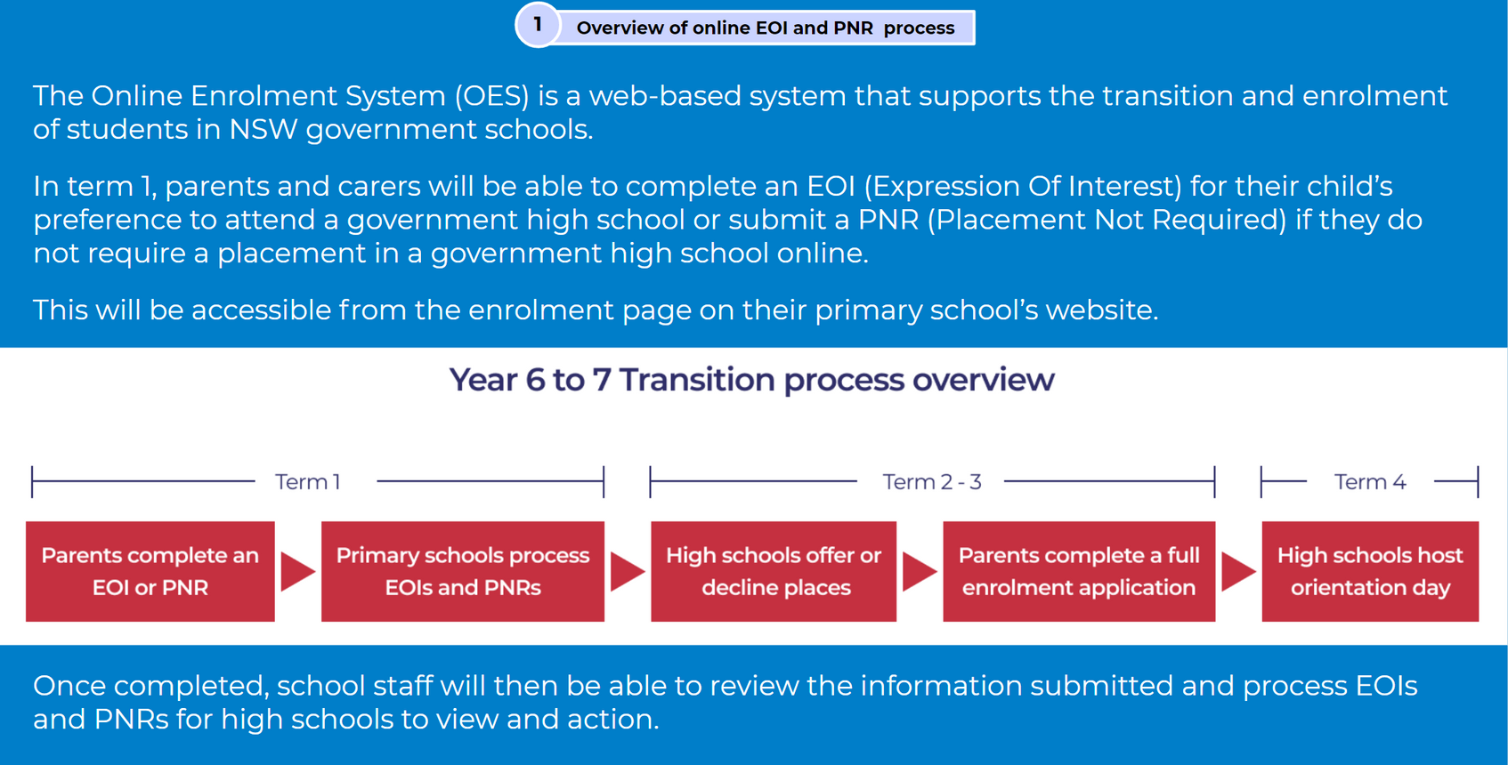
THE ENROLMENT PROCESS
*Online EOI Closes 28th March

Slide 15
THE ENROLMENT PROCESS CONT.
LOCAL ENROLMENT
OUT OF ZONE ENROLMENT
SPECIALIST SETTING ENROLMENT
  Students attend all transition activities at CHS
  EOI Window open from Week 6 till 9 Term 1
  Once you have submitted the EOI form -You will receive an offer email. You will need to follow the instructions to complete the enrolment which includes the upload of documents
  Students from non - partner primary schools attend transition activities at CHS as well as local high school
  OOZ Placement Panel:
Round 1 - Starts 12th May and finishes 30th May
Round 2 - Starts 10th June and finishes 27th June
  Students can attend all transition activities at CHS
  2 x specialist setting transition in Term 4 (individualised transition as required)
  Placements from panel outcomes - Term 3/4 2025
ONLINE ENROLMENT SYSTEM:
Birth Certificate
100 POINTS OF ID
Immunisation Certificate
Copy of MediCare Card

Slide 16
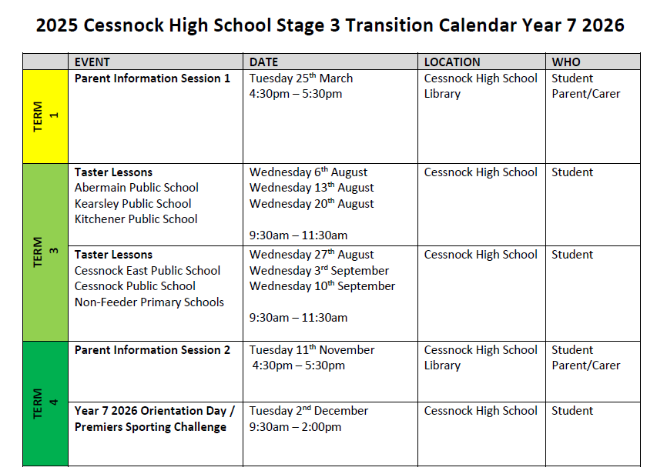
TRANSITION CALENDAR / EVENTS

Slide 17
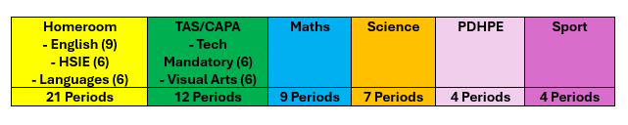
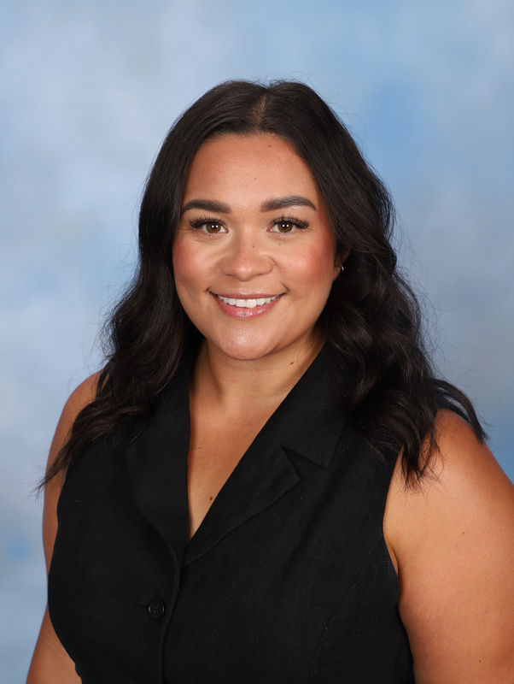
MIDDLE SCHOOL STRUCTURE
MISS KELSEY KISINA
HEAD TEACHER MIDDLE SCHOOL

Slide 18
MIDDLE SCHOOL STRUCTURE
CLASS PLACEMENT ASSESSMENTS
  TERM 4, WEEK 5 - CHS STAFF TO ATTEND PARTNER PRIMARY SCHOOLS TO ADMINISTER TESTING.
  THIS DATA IS USED TO CREATE OUR OPPORTUNITY CLASS.
OPPORTUNITY CLASS
  7O + 8O ENGAGE IN THE SAME CURRICULUM AS THEIR PEERS, BUT HAVE THE OPPORTUNITY TO PARTICIPATE IN EXTRA-CURRICULAR ACTIVITES SUCH AS COMPETITIONS AND PROJECTS
MISS KELSEY KISINA
HEAD TEACHER MIDDLE SCHOOL

Slide 19
NEXT PARENT INFORMATION SESSION
TUESDAY 11TH NOVEMBER
  STAFF INTRODUCTIONS
  FACULTY / SUBJECT INFORMATION
  PAPERWORK / BOOK PACKS
  KEY DATES FOR 2026
  PARENT PORTAL
  YEAR 7 CAMP INFORMATION
  SCHOOL INITIATIVES
  QUESTIONS

Slide 20


FOLLOW US ON FACEBOOK

Slide 21

QUESTIONS
&
SCHOOL TOUR

